Slide 1


Slide 2
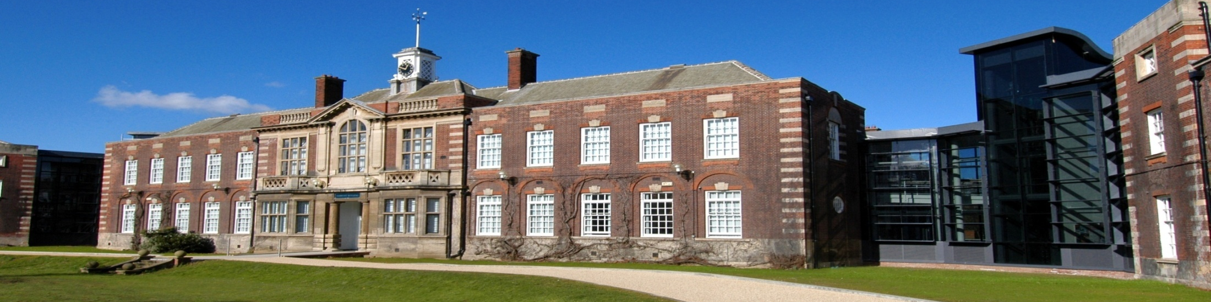
Halal knocking the Doors of non-Muslim`s Markets/Businesses
Rana Muhammad Ayyub (PhD Scholar)
HUBS(Hull Business School),
University of Hull, UK

Slide 3

Halal is not for only Muslims but also for non-Muslims.
Halal is for around more than 6.5 Billion People of the world.

Slide 4
REVIEW OF LITERATURE
Halal has emerged one of the prominent Brand in recent ages (Jonathan A.J. Wilson and Liu., 2010).
There is a strong demand of Halal products in a number of non-Muslim countries (Berry, 2008).
The halal food market is considered the fastest growing market in the world owing to two reasons firstly increasing Muslim population secondly changing local tastes(Syed Shah Alam and Sayuti, 2011).
Halal is considered also as the benchmark for safety and quality assurance (Syed Shah Alam and Sayuti, 2011).

Slide 5
The demand of Halal products has increased in many non-Muslim countries (Bonne and Verbeke, 2008, Berry, 2008).
As per some estimates there is 3 Trillion Halal market annually (Ayyub and Bilal, 2011).
(Sabri, 2006) reported an increase of 20% sale in the businesses (in KFC, Burger King and Taco bell)by just offering halal offerings on their shelves.
(Administrator, 2010) reported that many non-Muslim consumers buy the halal products from hundred Halal butcheries found all over UK.

Slide 6
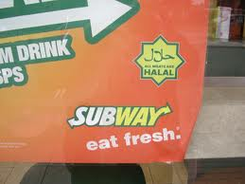
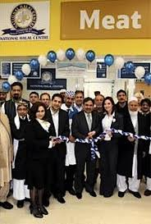
EVIDENCES FROM GIANT BUSINESSES
To meet this demand Global business Giant companies are introducing Halal products/services.
Halal food market in UK alone is estimated to be 700 million pounds. Similarly it has been reported that the biggest Superstore chain of UK has a plan to import 148 million pound worth halal items from Malaysia in next five years. (Grocer, 2007(b)).

Slide 7
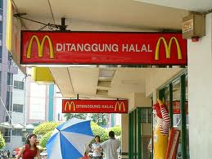

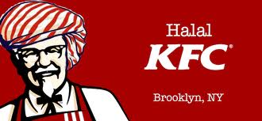
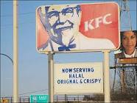
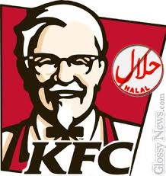

Slide 8


In France, fast food chain Quick - the number two burger chain in France after McDonald's, announced that 22 of its outlets would serve Halal meat only (BBC, 2010).

Slide 9
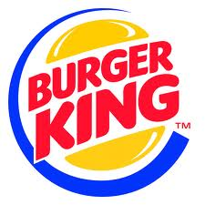
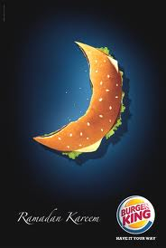
EVIDENCES Cont.
Burger King opened first Halal branch in 2005.

Slide 10



Many banks like HSBC and TSB Lloyds have offered Halal accounts and 25% of these accounts are being opened by British non Muslims (Knight, 2006).

Slide 11
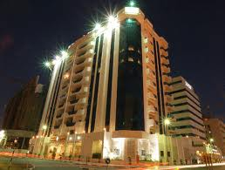
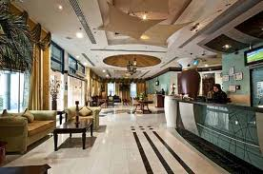
Al-Jawhara Hotels of Dubai, first Islamic Hotel in Dubai, claim that 60% of their clientele are non-Muslims (Asif, March 29, 2011).

Slide 12
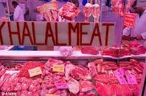
EVIDENCES Cont.
According to (Spedding, 2010) in UK, a large amount of Halal meat sheep is eaten by non-Muslims in the ethnic restaurant sector which further drives up the demand for it.
It has been reported by (Administrator, 2010) that many non-Muslim consumers buy the halal products from hundred Halal butcheries found all over UK.

Slide 13
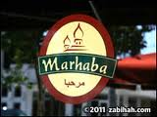
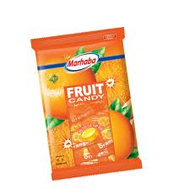
(Asif, March 29, 2011) has quoted that Marhaba, a Dutch based company sells cookies and chocolates and quarters of their customers are non-Muslims because of Food safety.

Slide 14
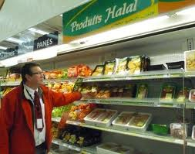
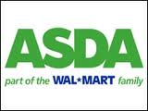
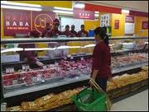
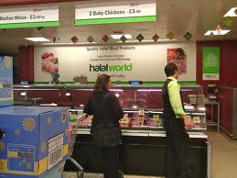
Auchen
ASDA

Slide 15

EVIDENCES Cont.
According to (BBC, 2010), Harrow Council said it had received "no complaints" about serving halal. There is evidence that 52 primary schools in the area will have the option of taking part in the same programme

Slide 16
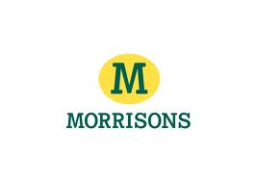
EVIDENCES Cont.
(Ted Shoemaker and Correspondent, 2006) has reported that there is a sale of Around $ 4 Billion in UK alone.
In UK, Morrison has started halal offering on 20 stores (Ahmed, 2008).

Slide 17
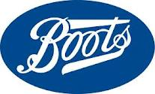
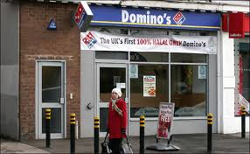
Boots, a UK chemist chain is running a trial of Halal baby food in 30 stores.
Domino`s Pizza

Slide 18
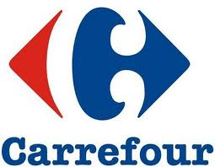
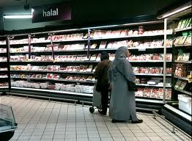
Carrefour of France

Slide 19
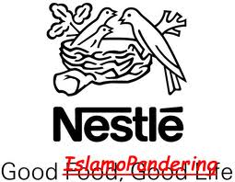
Nestle is offering Halal products in UK, Germany and France and halal products are sold in 1000 stores in five European countries.

Slide 20
REFERENCES
ADMINISTRATOR (2010) Halal Market overview.
AHMED, A. (2008) Marketing of halal meat in the United Kingdom: Supermarkets versus local shops. British Food Journal 110, 655-670.
AYYUB, R. M. & BILAL, M. (2011) Status of Pakistani Halal meat; and forecasting it`s export revenue, implications and opportunities. Interdisciplinary Journal of Contemporary Research in Business (IJCRB), 2, 1081-1092.
BBC (2010) Harrow primary schools offer 'halal-only' meat option A north London council is offering its primary schools the chance to serve only halal meat on its menus. News London.
BERGEAUD-BLACKLER, F. (2006) Halal: d`une norme communautaire a une norme institutionnelle. Journal des Anthropologues: Des Normes a Boire et a Manger, 106/107, 77-103.

Slide 21
BERRY, B. (2008) Global Halal Food Market Brief. IN CANADA, A. A. A. F. D. O. (Ed.). Canada.
BODO B. SCHLEGELMILCH & OBERSEDER, M. (2010) Half a century of Marketing ethics: Shifting perspectives and emerging trends. Journal of Business ethics, 93, 1-19.
BONNE, K. & VERBEKE, W. (2008) Religious values informing halal meat production and the control and delivery of halal credence quality. Agriculture and Human Values 25, 35-47.
DELENER, N. (1994) Religious contrasts in consumer decision behavior patterns: Their dimensions and marketing implications. European Journal of Marketing, 28, 36-53.
GROCER (2007(b)) Growing appetite for Halal food. The Grocer.
JONATHAN A.J. WILSON & LIU., J. (2010) Shaping the Halal into Brand? Journal of Islamic Marketing 1, 107-123.
KNIGHT, J. (2006) Non-Muslims snap up Islamic accounts. BBC News online Business section. BBC News.
MOKHLIS, S. (2009) Relevancy and measurement of religiosity in consumer behavior research. International Business Research, 2, 75-84.
NASEEM, CHOWDRY, S. & SHABBIR, H. (2010) An analytical study of Halal marketing in UK. HUBS. Hull, University of Hull, UK.

Slide 22
PETTINGER, C., HOLDSWORTH, M. & GERBER, M. (2004) Psychosocial influences on food choice in Southern France and Central England. Appetite, 42, 307-313.
SABRI, M. (2006) Singapore expands e-certification of halal products.
SCHLEGELMILCH, B. B. & KHAN, M. M. Animosity against religious minorities: A conceptual model of antecedents and intentions to purchase products with religious endorsements.
SPEDDING, A. (2010) The Halal market for sheepmeat.
SYED SHAH ALAM & SAYUTI, N. M. (2011) Applying the Theory of Planned Behaviour (TPB) in Halal food purchasing. International Journal of Commerce and Management, 21, 8-20.
TED SHOEMAKER & CORRESPONDENT, Q. (2006) Growing Muslim population in Europe spurs market for Halal food products. Fort Lee, EW Williams Publications Company, USA.

Slide 23

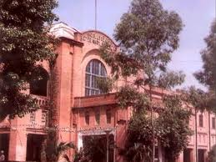
QUESTIONS !!!
Rana Muhammad Ayyub
drranaayyub@gmail.com
Assistant Professor (Marketing)
University of Veterinary & Animal Sciences, Lahore, Pakistan

Slide 24
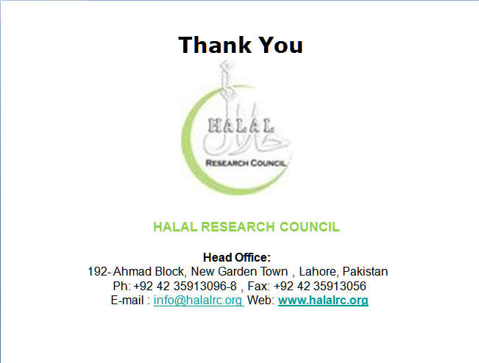

Thank You
HALAL RESEARCH COUNCIL
Head Office:
192- Ahmad Block, New Garden Town , Lahore, Pakistan
Ph: +92 42 35913096-8 , Fax: +92 42 35913056
E-mail : info@halalrc.org Web: www.halalrc.org

